Slide 1
Audio Source Separation
Team: Go Deep
Team Members:
Pratikhya Ranjit(190639)
Rishabh Katiyar(190702)

Slide 2
Problem Statement
Audio clips mainly have two components: Vocal & Instrumental
Separating the two components has several applications:
Music classification
Lyrics transcription
Recommendation system
Karaoke
Our goal is to separate vocal component from audio clips using deep learning.

Slide 3
Dataset & Preprocessing
The dataset we have used for training our model is MIR-1K.
MIR-1K dataset consists of 1000 song clips each of duration from 4 to 13 sec
2 channel audio:
Left channel: Music accompaniment
Right channel: Singing voice(Both male and female)
Preprocessing
Audio is downsampled to 8192 Hz to reduce input size
Short-time-fourier-transform is computed for audio clips
Magnitude spectrogram extracted from STFT
Voice, accompaniment and mixed audio processed separately for training U-Net

Slide 4
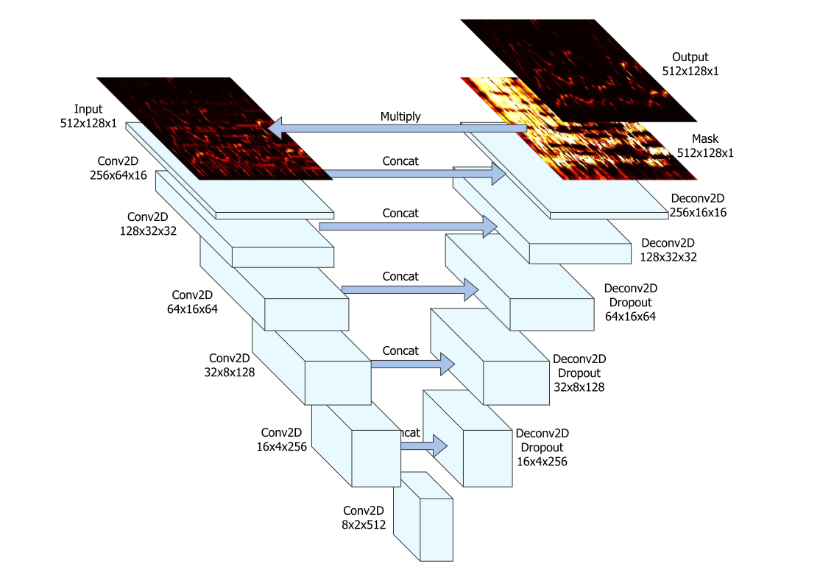
U-Net Architecture
Image Source: Singing Voice Separation With Deep-U-Net Convolutional Networks

Slide 5
Architecture
Encoder Layer : 6 strided 2D convolution layers with same padding of stride 2 and kernel size 5x5 with batch normalization and activation function as leaky ReLu.
Decoder Layer : 5 strided deconvolution layers with stride 2, kernel size 5x5 with batch normalization and activation function as ReLu with a dropout of 50% in the first 3 layers
The Final layer has a sigmoid activation function that makes the mask.
Optimizer : Adam
Loss function : L1 loss = ||f(X,Θ) ☉ X - Y ||
where f(X,Θ) is the mask generated and X is input mixture spectrogram, while Y is the target spectrogram.
Two U-Nets, Θ_{v} and Θ_{i} , are trained to predict vocal and instrumental spectrogram masks, respectively.

Slide 6
Model
We have used the U-Net Architecture for audio source separation.
Some of the main features of this architecture are
Each layer halves the size of the image but doubles the number of channels encoding the spectrogram into a small and deep representation.
That encoding is then decoded to the original size of the spectrogram by a stack of upsampling layers.
The Additional skip connections between the encoder and decoder allows low-level information to flow directly from the high-resolution input to the high-resolution output.
The neural network model operates exclusively on the magnitude of audio spectrograms. The audio signal for an individual (vocal/instrumental) component is rendered by constructing a spectrogram: the output magnitude is given by applying the mask predicted by the U-Net to the magnitude of the original spectrum, while the output phase is that of the original spectrum, unaltered
Thus finally the mask generated is again combined with the model phase of the original model and with inverse STFT , the individual voice and instrument signals are generated
Notes:
In the frequency domain however, even a minor linear shift in the spectrogram has disastrous effects on perception: this is particularly relevant in music sig-
nals, because of the logarithmic perception of frequency; moreover, a shift in the time dimension can become audible as jitter and other artifacts. Therefore, it is crucial that the reproduction preserves a high level of detail

Slide 7
Comparison and Evaluation
A baseline model similar to the U-Net Architecture is made in which the encoder and decoder architecture is the same but without the skip connections
To measure performance : Signal to Distortion (SDR) ratio, Signal to Interference Ratio (SIR), Signal to Artifact Ratio (SAR) are calculated using NUSSL library.
Libraries Used:
TensorFlow
Scipy
Librosa
NUSSL

